Slide 1
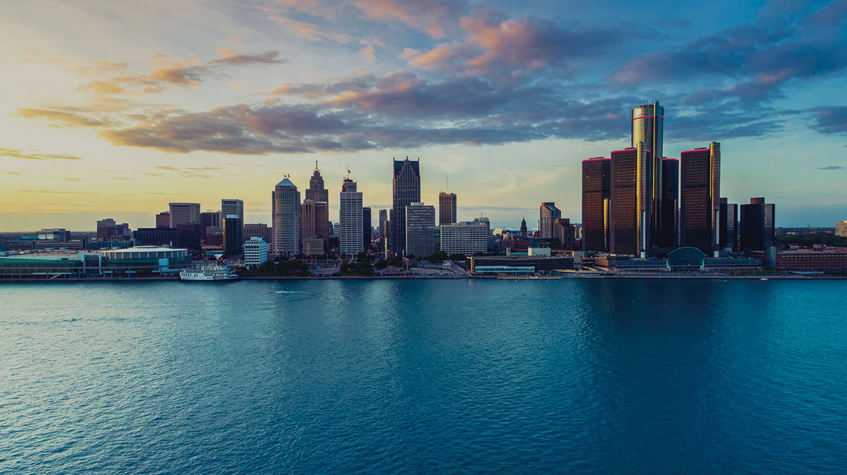
A CITY OF
BEAUTY
As a part of a new CITY OF BEAUTY strategy, DETROIT ACE will partner with other departments and community groups to support the creation of MURALS and ARTS ALLEYS in neighborhoods across the city.

Slide 2
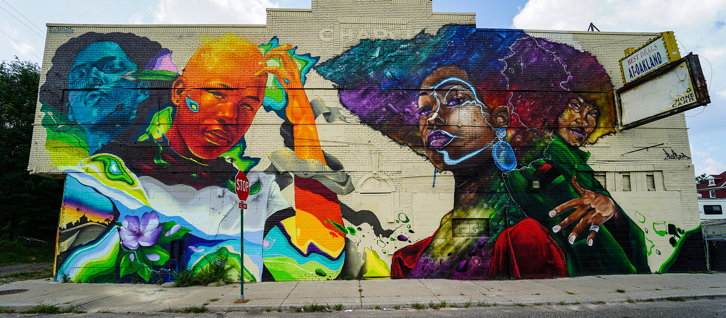
MURALS

Slide 3
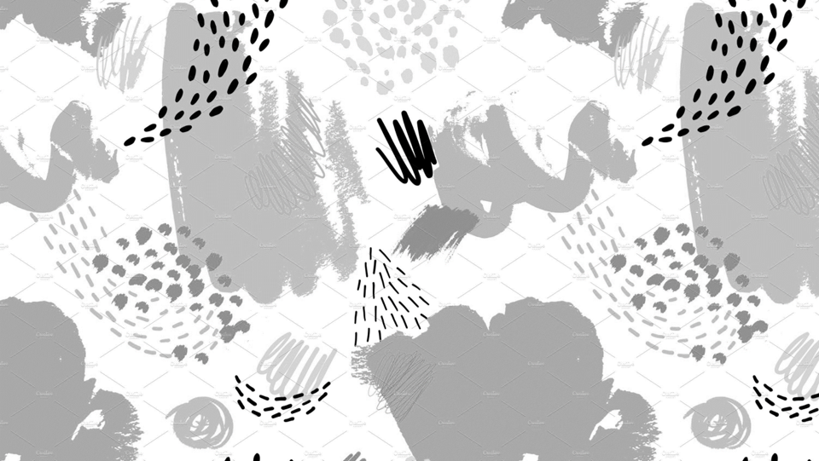
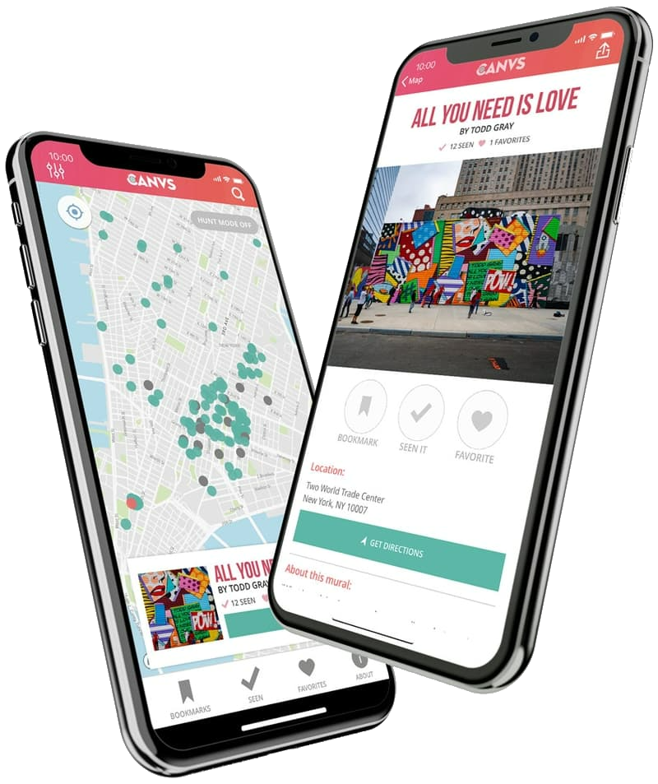
MURAL MAP + GUIDE
Detroit ACE supports the work of muralists and street artists to create public art across the city:
CANVS APP + MURAL MAP
Interactive map of every mural in the city
Use your phone to identify murals and learn about artists and mural programs
Special features like curated collections, self-guided tours and historical overlays
MURAL GUIDE
Learn how ACE can help you find artists and funds to create murals in your neighborhood
Understand the rules and regulations around murals and street art
Information for artists on how to register as a City vendor and pay for permits and supplies

Slide 4
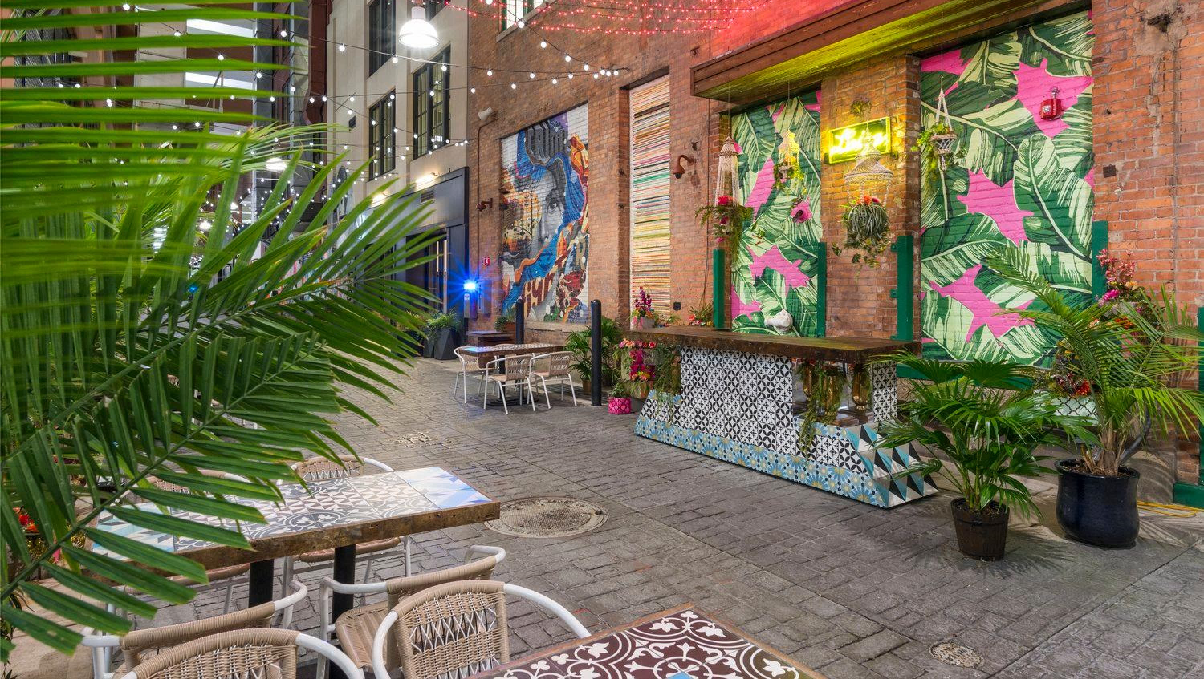
ARTS ALLEYS

Slide 5
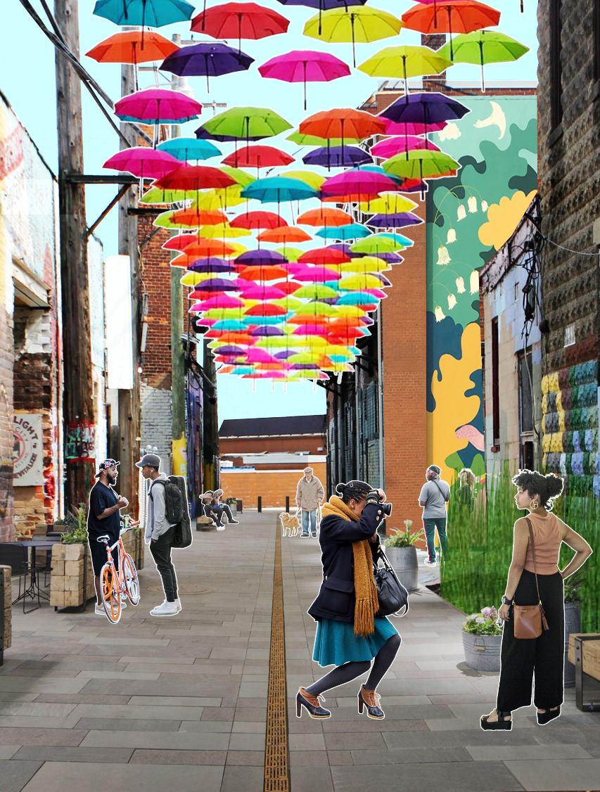
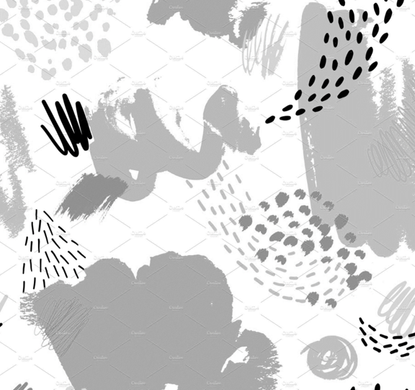
ARTS ALLEY INITIATIVE
The Arts Alley Initiative will use ARPA funds to transform five alleys in neighborhoods across the city. The project will:
SPUR NEIGHBORHOOD REVITALIZATION by making places for new businesses, recreation and community programs;
MITIGATE LOCALIZED FLOODING through low-cost and easily replicable stormwater strategies;
CREATE OPPORTUNITIES for the City’s creative workforce by integrating arts and culture into infrastructure improvements;
HIGHLIGHT NEIGHBORHOOD CREATIVITY through collaborative storytelling and artmaking to uplift local histories and support positive neighborhood change.
Concept Image

Slide 6
HOW TO GET INVOLVED
Stay tuned for big announcements coming soon on the first round of locations of MURALS and ARTS ALLEYS at detroitmi.gov/ace.
Please watch the inaugural DETROIT ACE HONORS and STATE OF THE ARTS address at 2 p.m. April 12th on the City of Detroit Facebook page, the City of Detroit YouTube channel, and City Channel 22. A program saluting the honorees will also be broadcast at 7 p.m. April 12th on City Channel 22 in Detroit and Comcast Channel 900 across the state.
Sign up for the next FREE ENTREPRENEURSHIP WORKSHOP for artists at detroitmi.gov/ace, which begins at 6 p.m. on Tuesday, April 19th.
CONTACT US
Rochelle Riley, Director of Arts and Culture | Rochelle.Riley@detroitmi.gov
Samuel Coons, Program Manager | Samuel.Coons@detroitmi.gov

